Slide 1
Clamping and Switching Circuits
Muhaimin Bin Munir

Slide 2
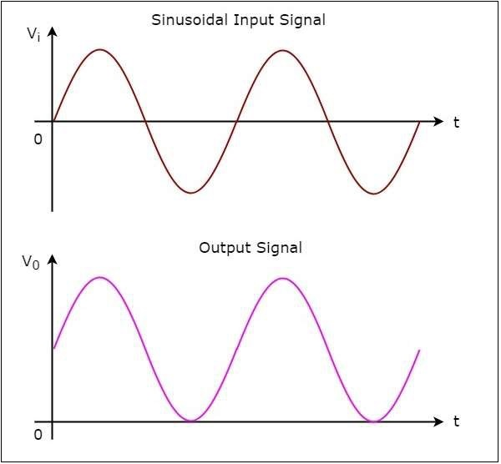
Clamper Circuit
A clamper is an electronic circuit that fixes either the positive or the negative peak excursions of a signal to a defined value by shifting its DC value. The clamper does not restrict the peak-to-peak excursion of the signal, it moves the whole signal up or down so as to place the peaks at the reference level.

Slide 3
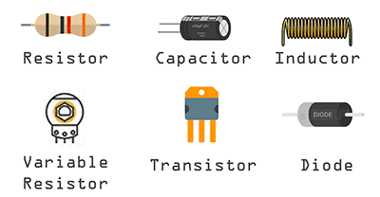
Clamper Circuit
A basic clamper circuit consists of Diode, Resistor and Capacitor.

Slide 4
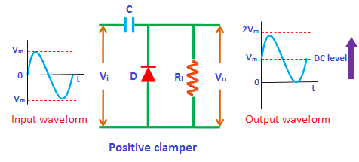
Positive Clamper Circuit

Slide 5
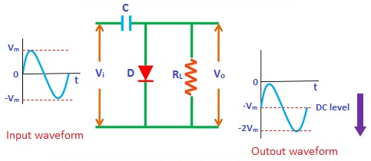
Negative Clamper Circuit

Slide 6
Clamper Application
The complex transmitter and receiver circuitry of television clamper is used as a base line stabilizer to define sections of the luminance signals to preset levels.
Clampers are also called as direct current restorers as they clamp the wave forms to a fixed DC potential.
These are frequently used in test equipment, sonar and radar systems.
For the protection of the amplifiers from large errant signals clampers are used.
Clampers can be used for removing the distortions
For improving the overdrive recovery time clampers are used.
Clampers can be used as voltage doublers or voltage multipliers.

Slide 7
Reference
https://www.tutorialspoint.com/electronic_circuits/electronic_clamper_circuits.htm
https://www.physics-and-radio-electronics.com/electronic-devices-and-circuits/rectifier/clampercircuits.html
https://www.circuitstoday.com/diode-clamping-circuits
https://www.youtube.com/watch?v=7O3Hbkkt624
https://www.elprocus.com/types-of-clipper-and-clamper-circuits-and-applications/
https://coefs.uncc.edu/dlsharer/files/2012/04/B8.pdf
Text Book (Obviously xD)

Slide 8
“Everything should be made as simple as possible, but not simpler” Albert Einstein

